Slide 1

Reference and Document Aware Semantic Evaluation
Methods for Korean Language Summarization
2022.09.30.
DongHyun KIM
gmr4rnjs@gmail.com

Slide 2

Contents
Introduction
Related Work
Methodology
Experiment
Conclusion

Slide 3
Introduction
Text Summarization is to generate a reference summary of all the salient information of original document.
Two approach of text summarization.
Extractive approach – The most noticeable key sentences are extracted.
Abstractive approach – Paraphrased summary is generated from the source.
Most summarization models are evaluated using ROUGE(Recall-Oriented Understudy for Gisting Evaluation), which measures n-gram overlaps between generated and reference summaries.
But, ROUGE doesn’t reflect semantic meanings between generated and reference summaries.
Notes:
For example, when a person summarizes a document, they tend to use words that are implicit while not always using the explicit words from the original document
As the ROUGE score is computed based on an n-gram overlap, the score can be low even if two words have the same semantic meaning.

Slide 4
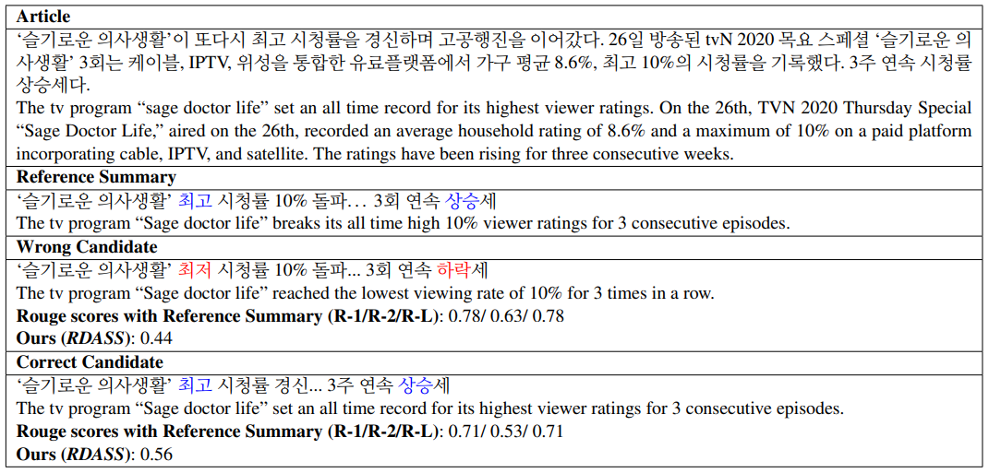
Introduction
The incorrectly generated summary has a high ROUGE score, but has the opposite semantic meaning.

Slide 5
Introduction
To overcome this limitation, an evaluation method that considers the semantic information of both the generated and reference summary is required.
In this study,
The evaluation metrics are proposed, which can be applied to a summarization model using deep semantic information.
The methods to improve the correlation between the proposed evaluation metrics and human judgment are proposed.

Slide 6
Related Work
Evaluation methods of text summarization
Extrinsic – a summarization model based on how it affects the completion of tasks comprising the judgment of document relevance
Intrinsic – automatic method evaluates quality by calculating its similarity to a manually generated summary.(pyramid method, basic-elements method, ROUGE.
ROUGE score does not account for synonymous words or phrase.
Like ROUGE-WE, many methods use a lexical matching method with a semantic similarity measure, but they require hand-crafted lexical and synonym dictionaries.
In this paper, a pre-trained neural network like SBERT will be used.
Notes:
The pyramid method inspects various human-made summaries and creates summary content units, each with a scoring weight.
The basic-elements method is similar to the pyramid method.

Slide 7
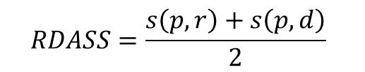

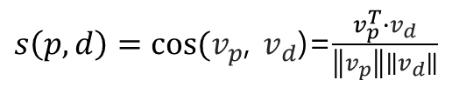
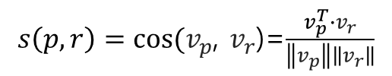
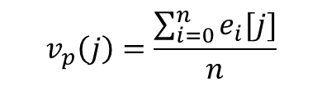

Methodology
Reference and Document Aware Semantic Evaluation(RDASS)
Define the source document -> $y_{d}=\left[w_{1},…,w_{n}\right]$ -------> $v_{p}$
Define the generated summary -> $y_{p}=\left[w_{1},…,w_{n}\right]$ ----> $v_{p}$
Define the reference summary -> $y_{r}=\left[w_{1},…,w_{m}\right]$ ----->$v_{r}$
$w_{i}$=each word
$$v_{p}\left(j\right)=\frac{\sum_{i=0}^{n}{e_{i}[j]}}{n}$$
$s\left(p,r\right)=cos⁡(v_{p}$, $v_{r}$)=$\frac{v_{p}^{T}∙v_{r}}{\left\|v_{p}\right\|\left\|v_{r}\right\|}$
$$RDASS=\frac{s\left(p,r\right)+s\left(p,d\right)}{2}$$
$s\left(p,d\right)=cos⁡(v_{p}$, $v_{d}$)=$\frac{v_{p}^{T}∙v_{d}}{\left\|v_{p}\right\|\left\|v_{d}\right\|}$

Slide 8
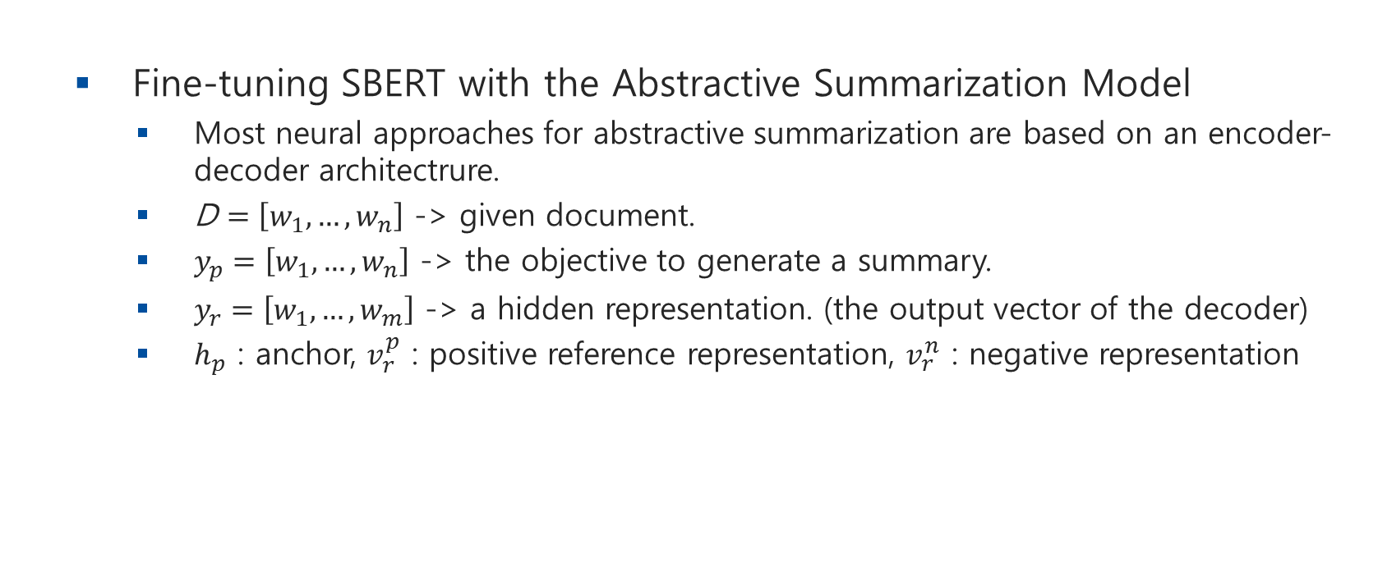
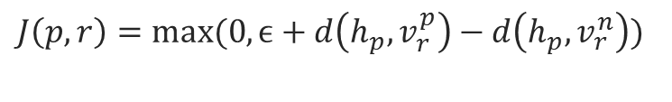

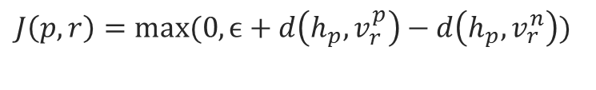
Methodology
Fine-tuning SBERT with the Abstractive Summarization Model
Most neural approaches for abstractive summarization are based on an encoder-decoder architectrure.
D $=\left[w_{1},…,w_{n}\right]$ -> given document.
$y_{p}=\left[w_{1},…,w_{n}\right]$ -> the objective to generate a summary.
$y_{r}=\left[w_{1},…,w_{m}\right]$ -> a hidden representation. (the output vector of the decoder)
$h_{p}$ : anchor, $v_{r}^{p}$ : positive reference representation, $v_{r}^{n}$ : negative representation
$$J\left(p,r\right)=max⁡(0, ϵ+d\left(h_{p},v_{r}^{p}\right)−d\left(h_{p},v_{r}^{n}\right))$$
$$J=J\left(p,r\right)+J(p,d)$$
$$J\left(p,r\right)=max⁡(0, ϵ+d\left(h_{p},v_{r}^{p}\right)−d\left(h_{p},v_{r}^{n}\right))$$

Slide 9
Experiments
Dataset
Using the Korean Daum/News dataset, comprising 10 topics.
The dataset contains articles from 143 newspapers.(each having different summary styles)
Human Judgment
Relevance – The degree of appropriateness of the document.
Consistency – The degree of factualness.
Fluency – The degree of the quality of generated summary.
Human avg – The average value of the scores for the three indicators.

Slide 10
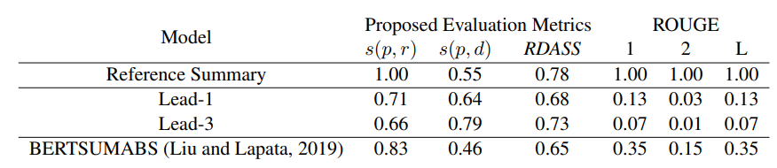
Experiments
Performance of the Summarization Model

Slide 11
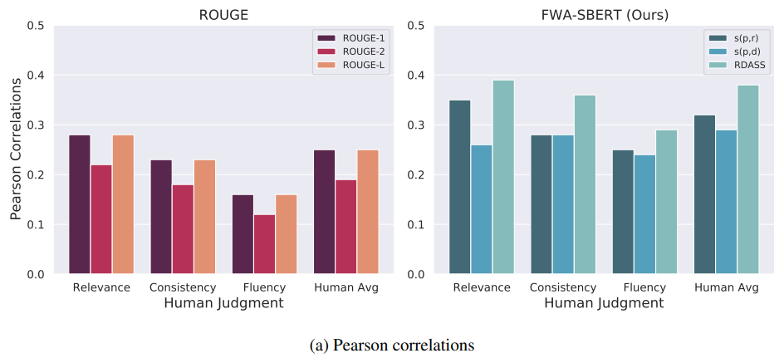
Experiments
Correlation with Human Judgment

Slide 12
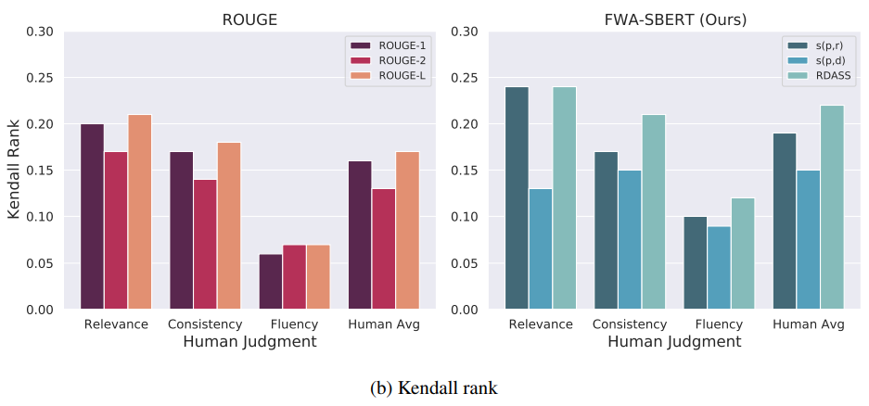
Experiments
Correlation with Human Judgment

Slide 13
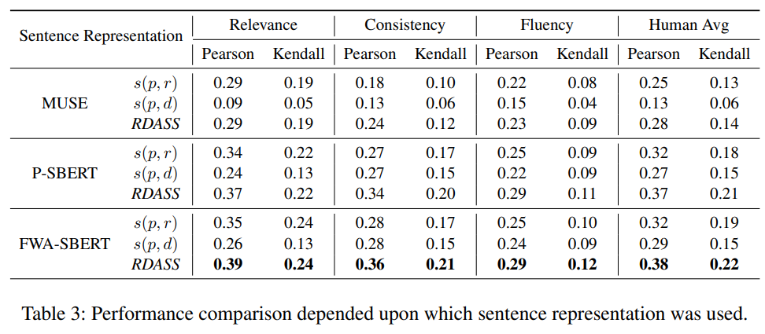
Experiments
Correlation with Human Judgment
Notes:
Multilingual Universal Sentence Encoder (MUSE): MUSE (Yang et al., 2019) is a multilingual sentence encoder that embeds text from 16 languages into a single semantic space using multi-task

Slide 14
Conclusion
Since Korean is an agglutinative language, the generated summary having the same semantic meaning with reference summary can be variously expressed.
To overcome this limitation, RDASS is proposed. The RDASS can reflect deep semantic relationships of a generated reference summary and document.
In future work, we will demonstrate the effectiveness of the proposed method in English summarization dataset.

Slide 15
Thank you for listening

